Slide 1

Modular Applications and the Lookup API
Tim Boudreau
Senior Staff Engineer
Sun Microsystems

Slide 2
The Need for Modular Applications
Applications get more complex
Assembled from pieces
Developed by distributed teams
Components have complex dependencies
Good architecture
  Know your dependencies
  Manage your dependencies

Slide 3
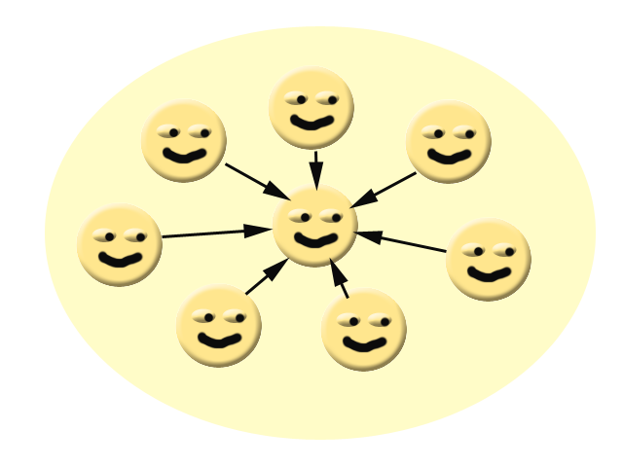
The Entropy of Software
Version 1.0 is cleanly designed...

Slide 4
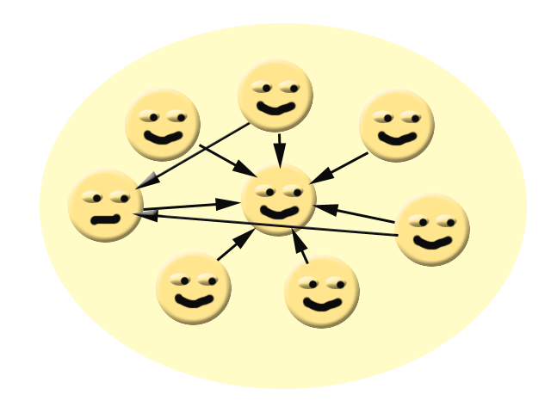
The Entropy of Software
Version 1.1...a few expedient hacks...we'll clean those up in 2.0

Slide 5
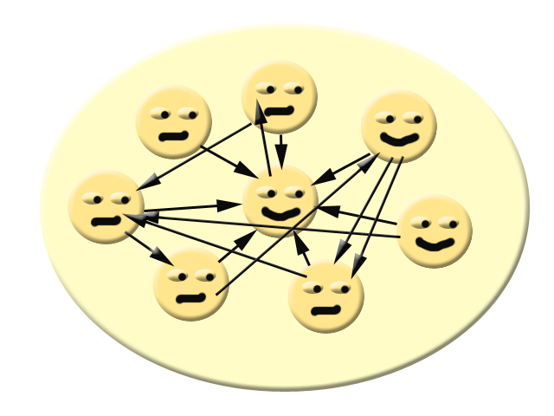
The Entropy of Software
Version 2.0...oops...but...it works!

Slide 6
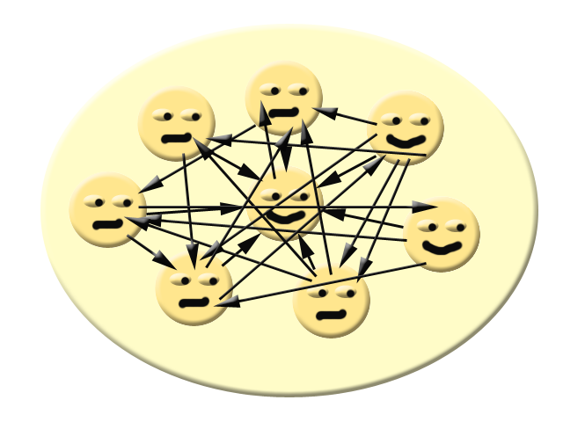
The Entropy of Software
Version 3.0...Help! Whenever I fix one bug, I create two more!

Slide 7
The Entropy of Software
Version 4.0 is cleanly designed. It's a complete rewrite. It was a year late, but it works...

Slide 8
The Entropy of Software
Version 4.1...does this look familiar?....

Slide 9

The Entropy of Software
TO BE CONTINUED....

Slide 10
Types of Library
Simple library – one impl, put it on classpath and use
Reference Impl + Vendor Impl – You trust that the Vendor impl conforms to the spec
Modular Library – the API is separate from the implementation
  Multiple implementations possible
  Spec conformance is enforced by design
  API must find its implementation
  You need a registry of things

Slide 11
Modular Applications
Discover their components at runtime
May add/remove/reload components at runtime
Must satisfy dependencies between components
Have API contracts between components
Run inside a runtime container

Slide 12
What is a NetBeans Module
It is just a JAR file – no magic
  Has some special manifest entries to describe it to NetBeans
  Editable in the Project Properties dialog for module projects
Distributed in an NBM file
  Basically a signed JAR file
  Contains metadata about the module
  May contain 3rd party JARs or anything else that needs to be on the system

Slide 13
NetBeans Module Manifest
Manifest-Version: 1.0
Ant-Version: Apache Ant 1.7.0
Created-By: 1.5.0_14-b03 (Sun Microsystems Inc.)
OpenIDE-Module-Public-Packages: -
OpenIDE-Module-Module-Dependencies: org.netbeans.api.java/1, ...
OpenIDE-Module-Java-Dependencies: Java > 1.5
OpenIDE-Module-Build-Version: 200804211638
OpenIDE-Module-Specification-Version: 2.12.0.4.1.1.6
OpenIDE-Module: org.netbeans.modules.java.editor/1
OpenIDE-Module-Implementation-Version: 4
OpenIDE-Module-Localizing-Bundle:
org/netbeans/modules/java/editor/Bundle.properties
OpenIDE-Module-Install:
org/netbeans/modules/java/editor/JavaEditorModule.class
OpenIDE-Module-Layer:
org/netbeans/modules/java/editor/resources/layer.xml
OpenIDE-Module-Requires: org.openide.modules.ModuleFormat1
AutoUpdate-Show-In-Client: false

Slide 14
Modular Runtime Containers Must
Ensure dependencies are satisfied
  Including requiring > version n of a module
Not allow illegal dependencies
Allow legal dependencies
Instantiate components of the system at runtime
Provide service registration/discovery facility

Slide 15
What is a NetBeans Module
It is just a JAR file – no magic
  Has some special manifest entries to describe it to NetBeans
Distributed in an NBM file
  Basically a signed JAR file
  Contains metadata about the module
  May contain 3rd party JARs or anything else that needs to be on the system

Slide 16
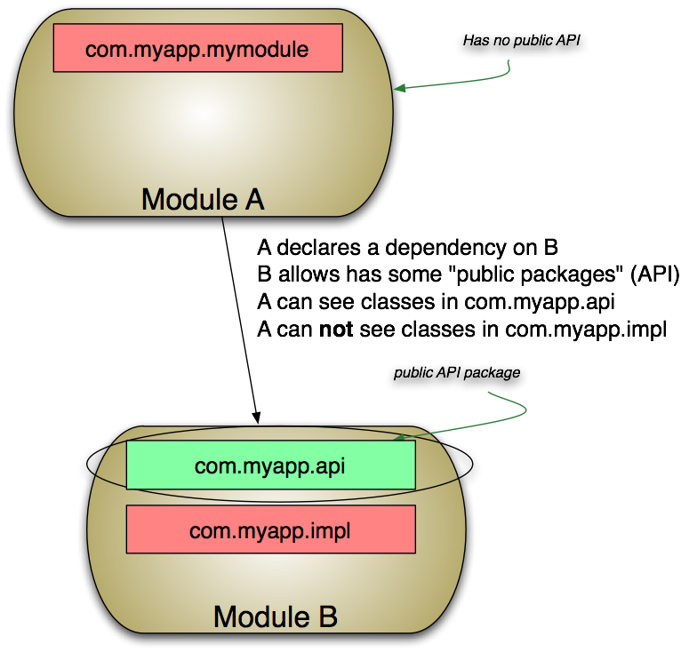
Enforcing Module Dependencies

Slide 17

Use an Existing Runtime Container
Rest In Peace, Home-made Frameworks 1995-2005

Slide 18
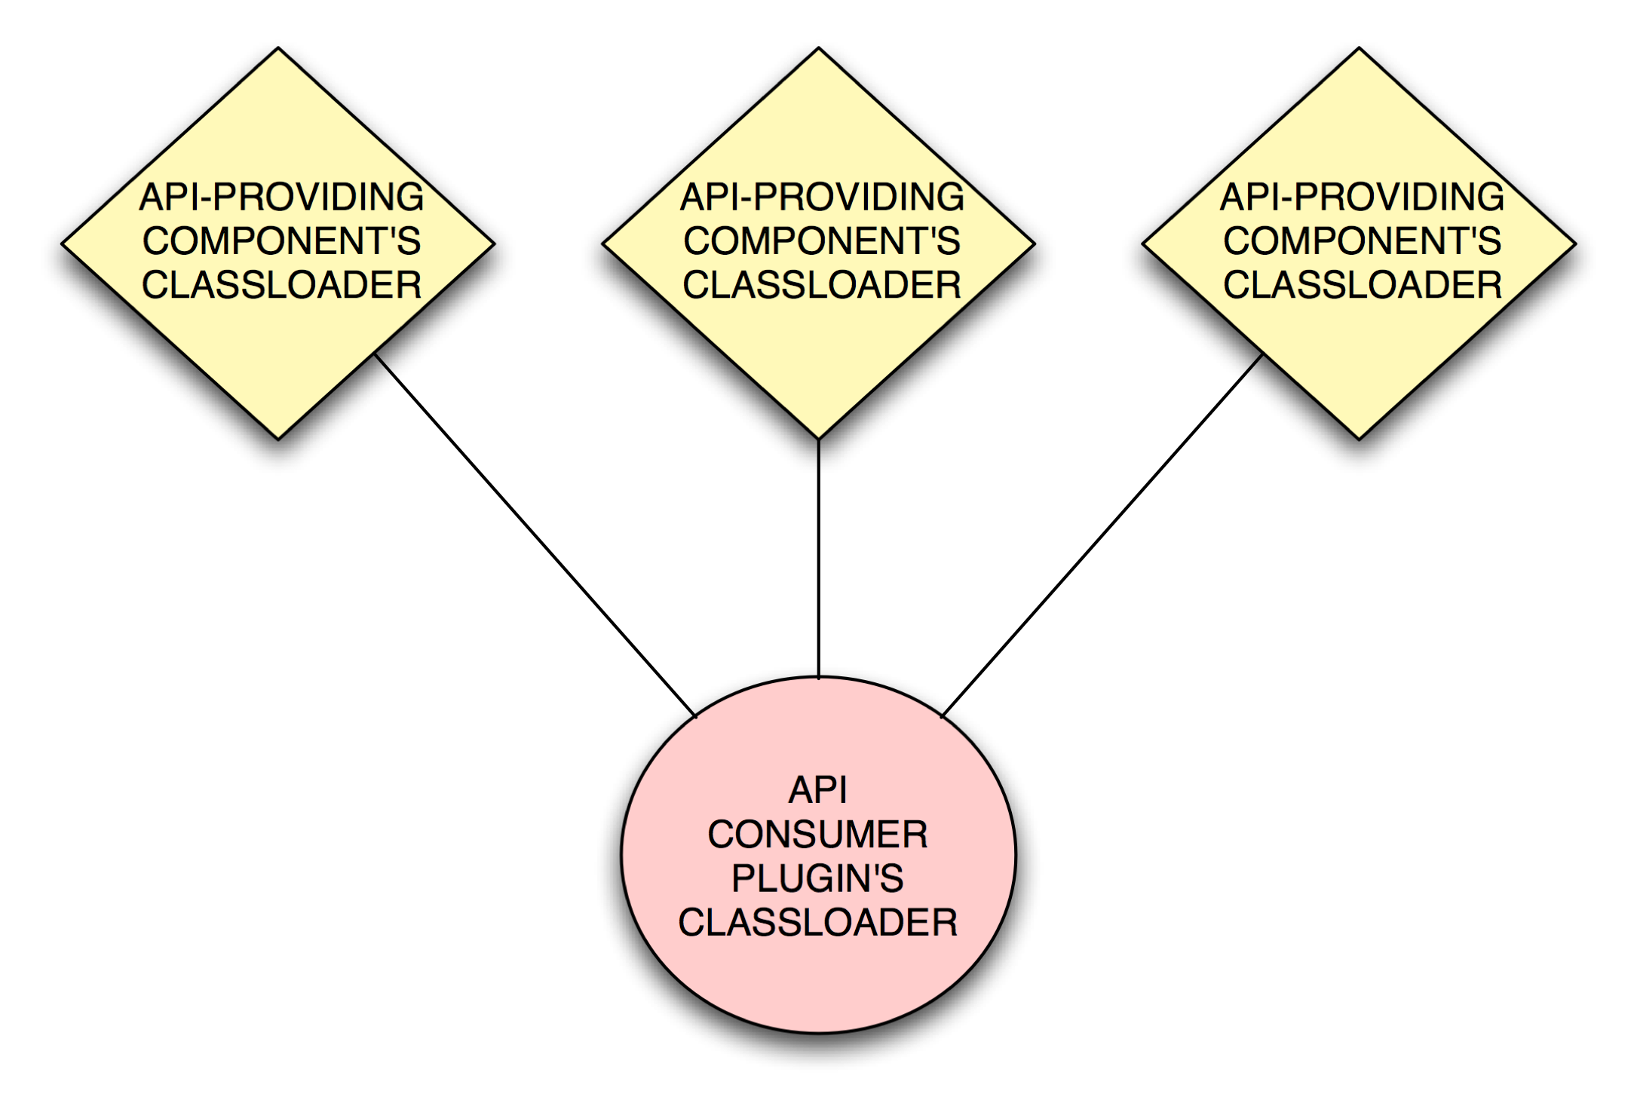
Class Loader Partitioning

Slide 19
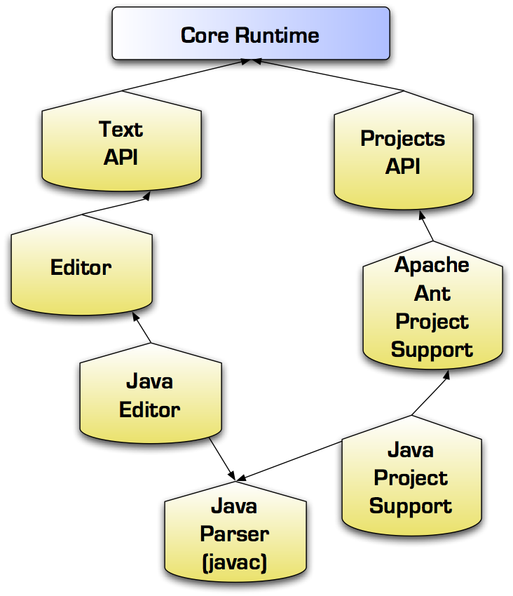
Module Dependencies

Slide 20
Provides/Requires Tokens
API can be in one module, implementation in another
API module can include a requires token in its manifest
OpenIDE-Module-Requires: Spellchecker
Implementation module includes a provides token in its manifest
OpenIDE-Module-Provides: Spellchecker
Modules needing the API only install if requirement is satisfied

Slide 21
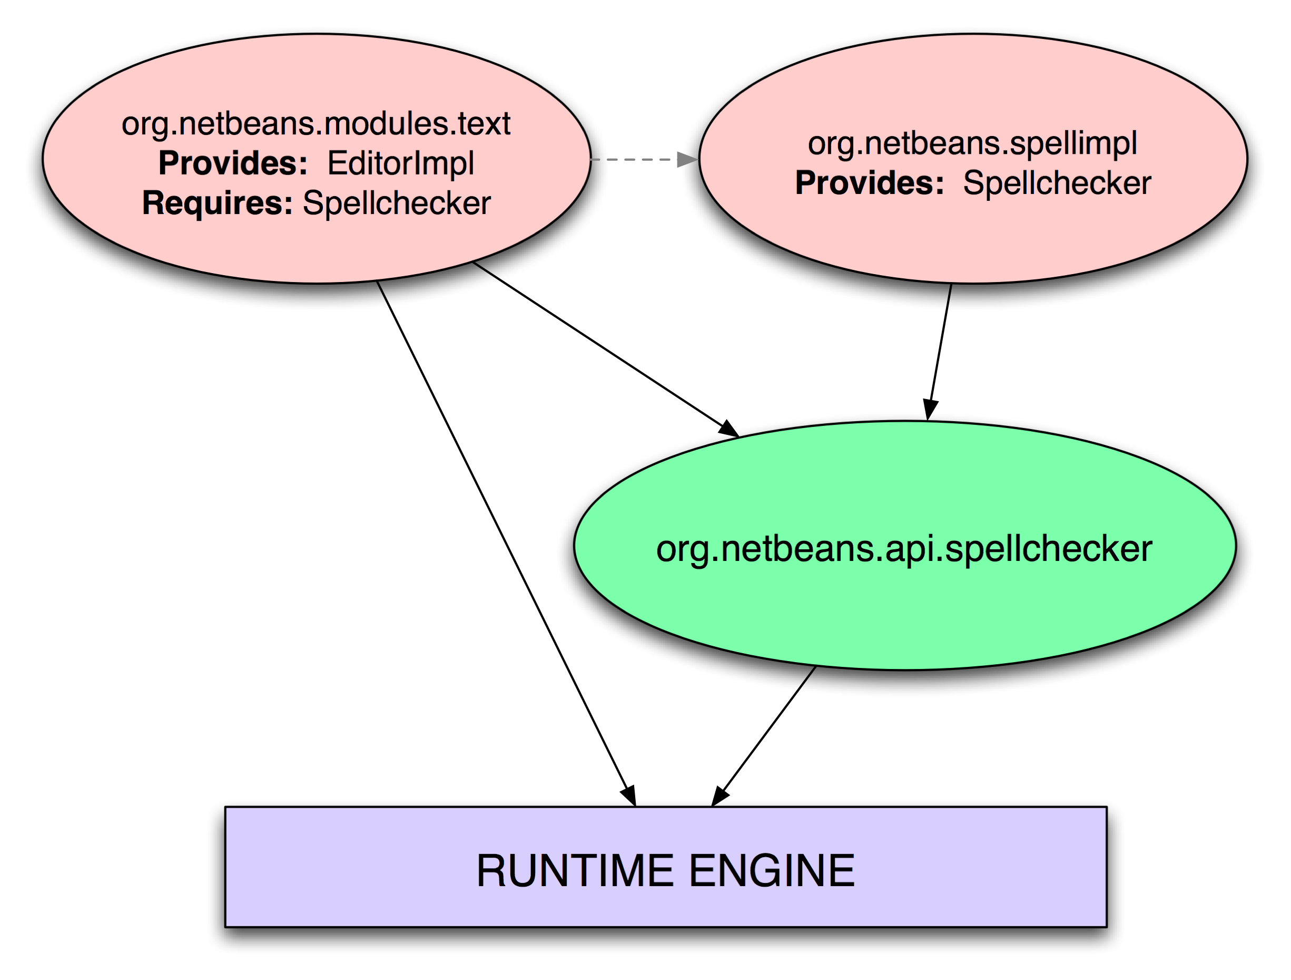
Modular Libraries and Discovery

Slide 22
Discovery and Dependencies
?
So how will the SpellChecker API find its implementation?

Slide 23
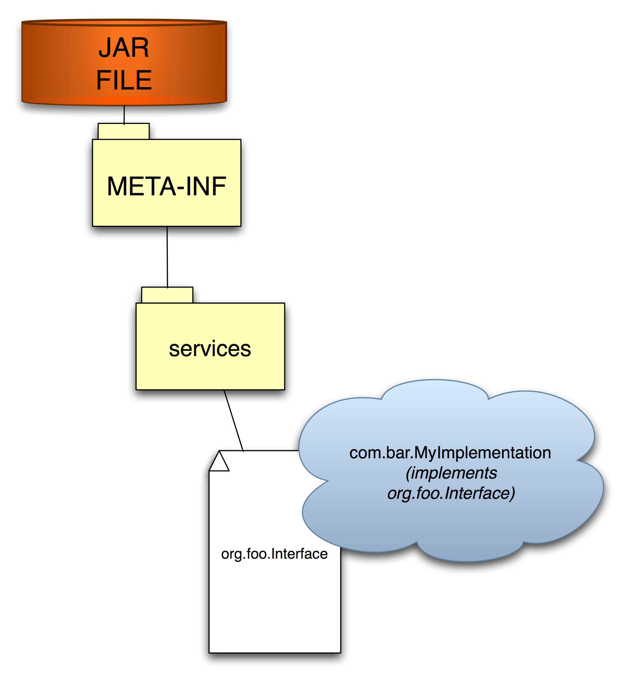
The Java Extension Mechanism
In JDK since 1.3
Easy with JDK 6's ServiceLoader.load()
Declarative registration
  No startup penalty
Plain-text file in META-INF/services
  Name is interface
  Content is FQN of implementation

Slide 24
Other Solutions
Global static singleton – why that's bad
  Why that's bad:
    Can never be garbage collected
    Locked in to one implementation
Setter injection – why that's bad:
  Can be changed later by foreign code
  A modular application may contain modules the original author did not write
  Introduces state – threading and synchronization issues
  “Push” model where we should be using a “pull” model
String-based registry (JNDI, etc.) - why that's bad:
  Not type-safe

Slide 25
Lookup – NetBeans Solution
Small, NetBeans independent library
  Part of NetBeans org-openide-util.jar
    org.openide.util.Lookup
Works with any version of Java (unlike JDK's ServiceLoader)
A Lookup is dynamic
  Can fire changes
A Lookup is instantiable
  You can make one and use it
Lookups are composable
  ProxyLookup can combine and switch between other lookups and fire changes

Slide 26
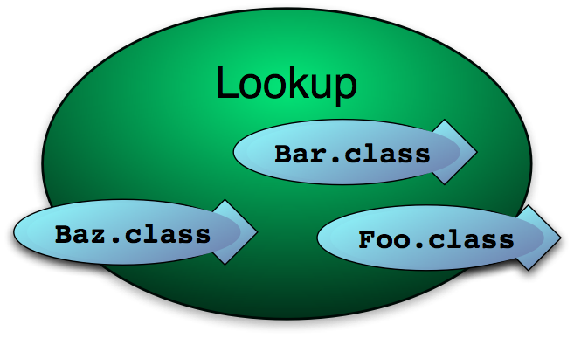
A Lookup is a place
A space objects swim into and out of
You can observe when specific types of object appear and disappear
You can get a collection all of the instances of a type in a Lookup

Slide 27
The Default Lookup – A global registry
Global Lookup Patterns
  Pseudo-singletons:
    StatusDisplayer x = Lookup.getDefault().lookup ( StatusDisplayer.class );
    Better memory management: The singleton can be garbage collected if nothing references it
  Global services
    Collection <? extends SomeClass> c = Lookup.getDefault().lookupAll( ProjectFactory.class );

Slide 28
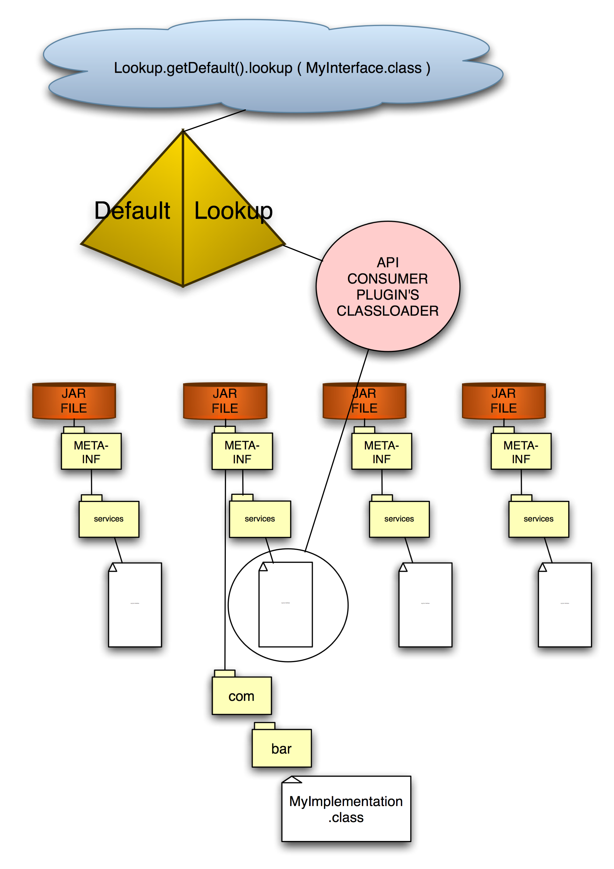
Lookup: Service discovery and more

Slide 29
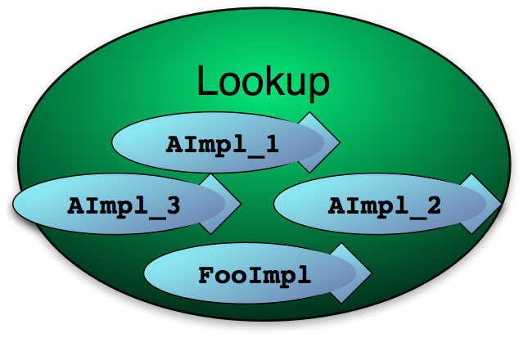
Can Contain >1 instance of a type
It's not just for singletons
Requesting multiple objects is easy:
    Collection <? extends A> c = Lookup.getDefault().lookupAll(A.class);

Slide 30
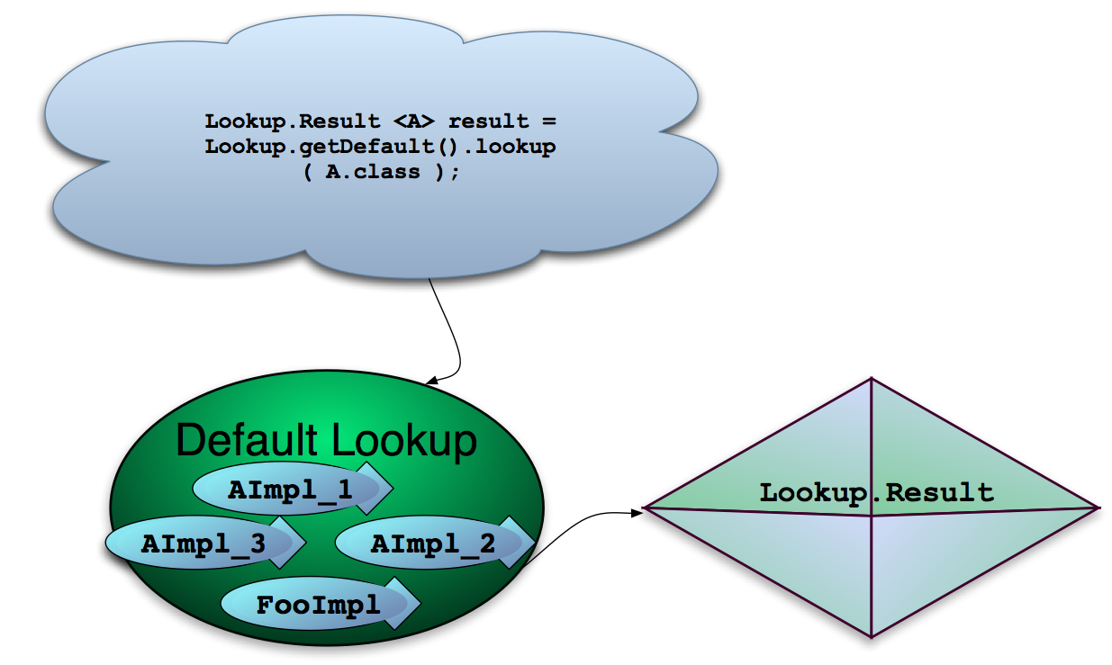
Lookup.Result – Keeping A Query Result

Slide 31
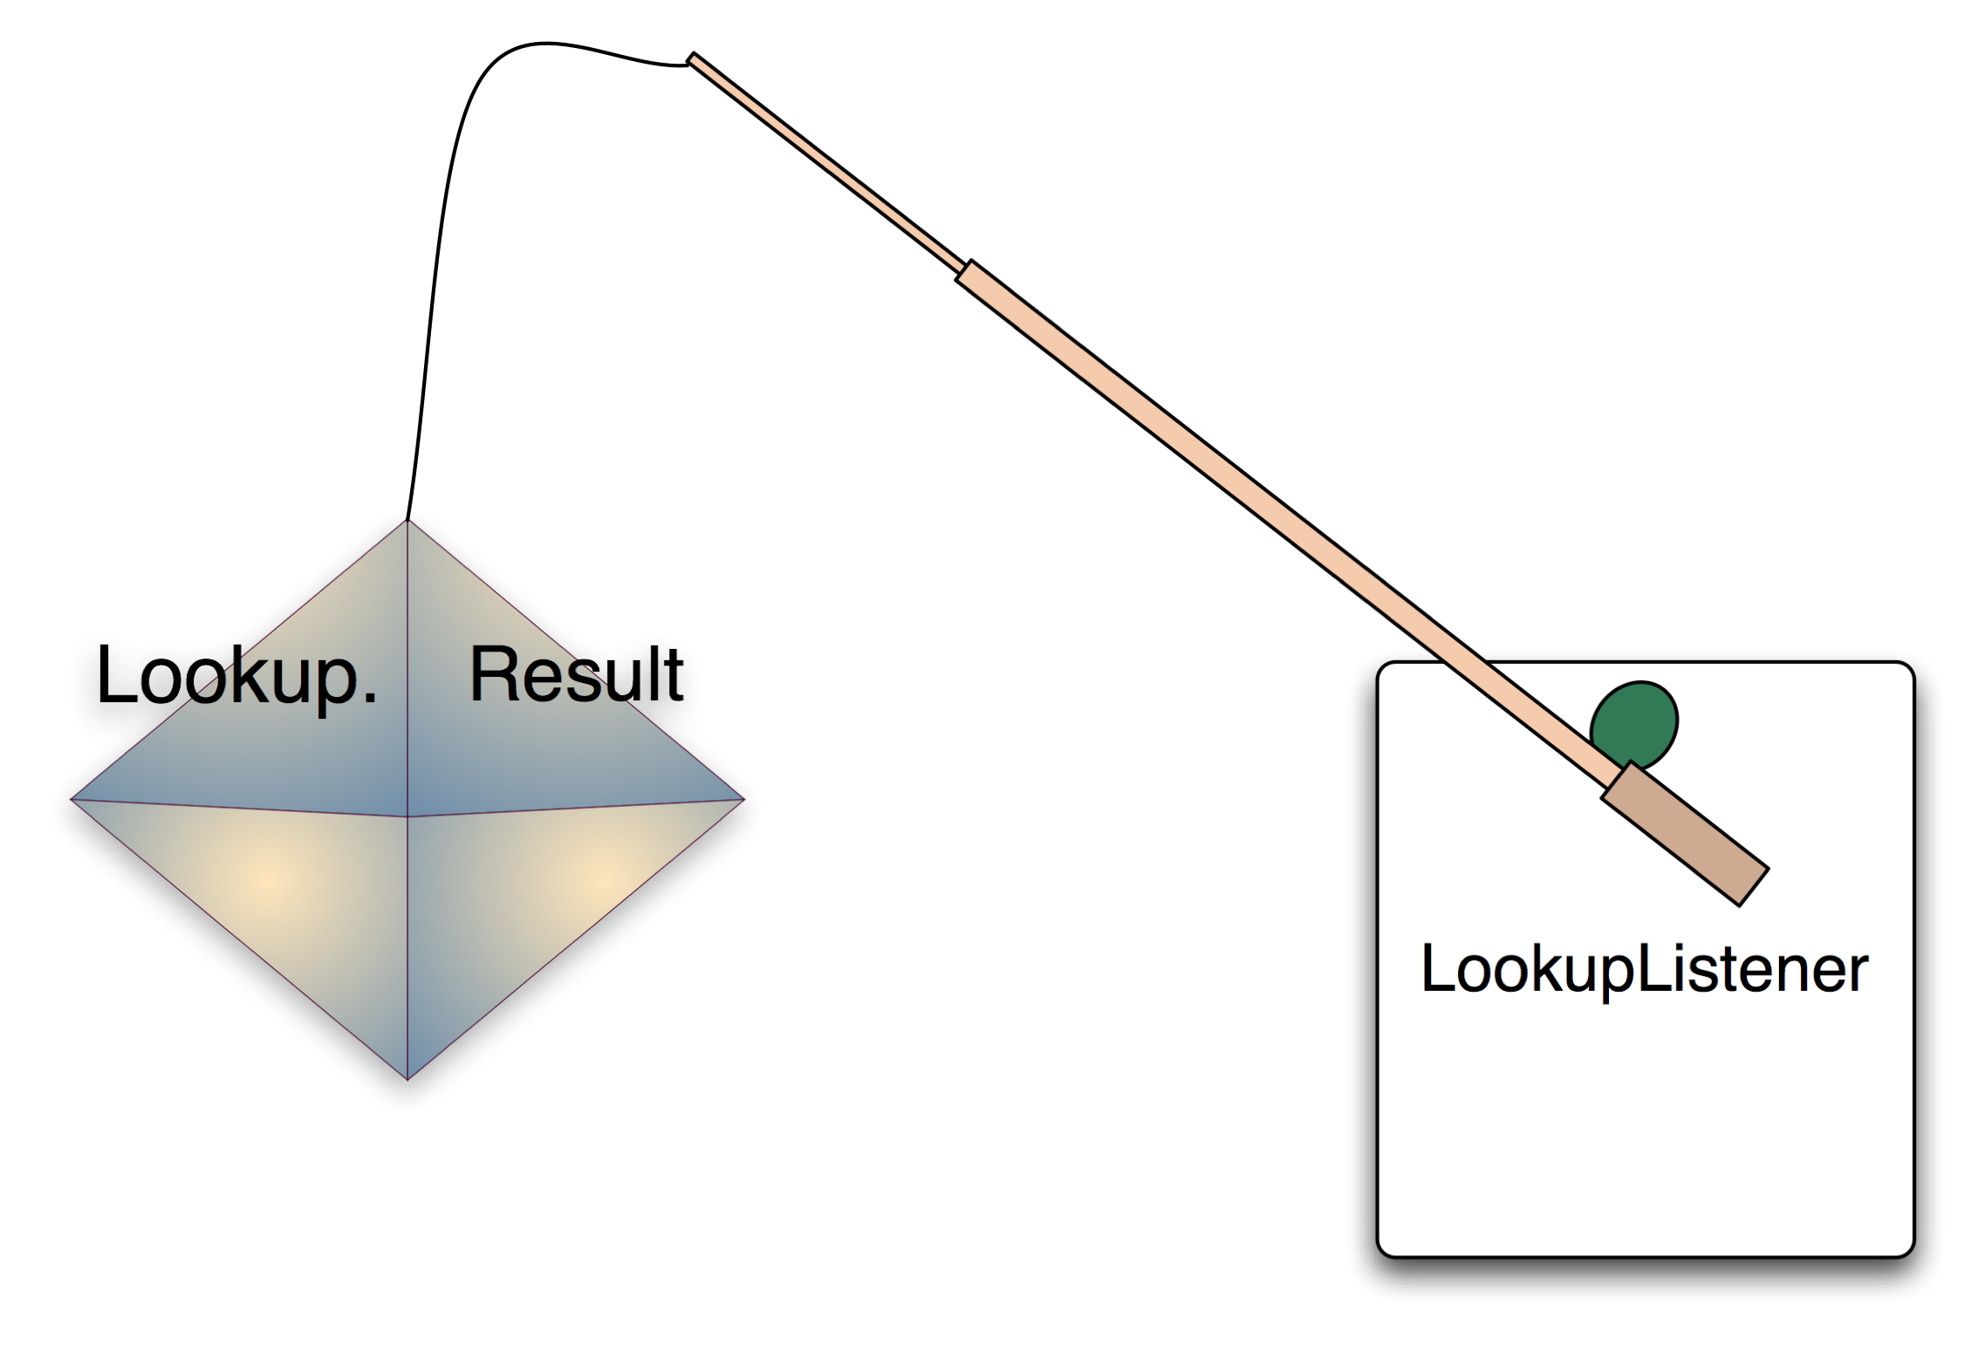
Tracking Changes in a Lookup

Slide 32
Listening To A Lookup.Result
Why do that?
  Default Lookup:
    Detect when a module is uninstalled/installed that provides something you are interested in
  Some object that owns a lookup
    Detect when the set of its “capabilities” change

Slide 33
Listening for Changes
Lookup.Result<SomeClass> r = someLookup.lookupResult ( SomeClass.class );
r.addLookupListener (new LookupListener() {
public void resultChanged (LookupEvent e) {
//handler code here
}
});

Slide 34
So...What's So Special About This?
?
What if objects had Lookups?
What if Lookups could proxy each other?

Slide 35
Example: NetBeans Project API
Associates a directory on disk with a Lookup
Defines interfaces that may be in that Lookup
public interface Project extends Lookup.Provider {
FileObject getProjectDirectory();
Lookup getLookup();
}

Slide 36
Example: Selection in NetBeans
Each main window tab has its own Lookup
  Some tabs show Nodes, which also have Lookups, and proxy the selected Node's Lookup
A utility Lookup proxies the Lookup of whatever window tab has focus
  What is “to proxy”?
Lookup lkp = Utilities.actionsGlobalContext();

Slide 37
Example: Selection in NetBeans
Demo

Slide 38
Creating Your Own Lookup – when?
When do you want to do this? Common cases:
  You are implementing a Project
    The Lookup provides objects that let code interact with the project
  You are writing a TopComponent (logical window)
    The Lookup provides its selection
  You are writing a Node
    The Node's Lookup contents determine what actions will be enabled, what is shown in the Navigator, etc.
  You are creating an API that other modules can inject objects into
    Your API classes can be final but still be extensible

Slide 39
Creating Your Own Lookup - How?
A Lookup that never changes
  org.openide.util.lookup.Lookups
    A utility class that provides some convenient Lookup implementations
You set the contents once and it stays this way forever
Lookup lkp = Lookups.fixed ( obj1, obj2, obj3 );
Lookup lkp = Lookups.singleton( onlyObject );

Slide 40
Creating Your Own Lookup - How?
AbstractLookup – lookup subclass
  org.openide.util.lookup.AbstractLookup
  Driven by an InstanceContent object
  You can add/remove/set the contents on the fly
    Appropriate changes will be fired to listeners
InstanceContent content = new InstanceContent();
Lookup lkp = new AbstractLookup ( content );
content.set ( obj1, obj2, obj3 );
content.remove ( obj3 );

Slide 41
Creating Your Own Lookup - How?
ProxyLookup
  Merge multiple lookups together
    A lookup that proxies a bunch of other lookups
  Can change which lookups are merged together on the fly
    And appropriate events will be fired
Lookup lkp = new ProxyLookup ( otherLookup1, otherLookup2, otherLookup3 );

Slide 42
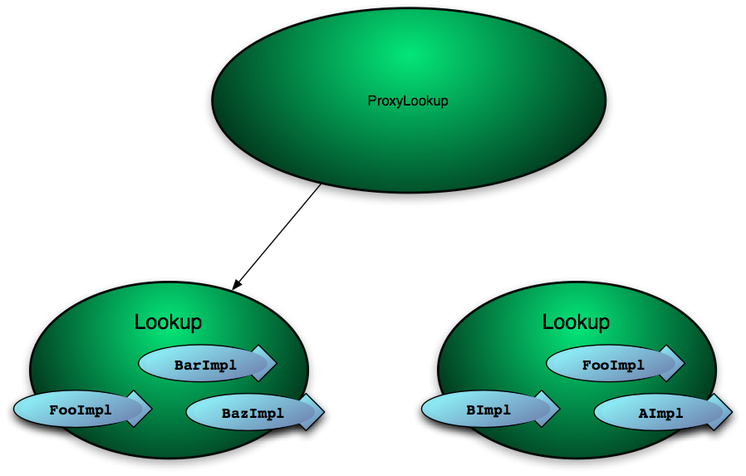
ProxyLookup

Slide 43

ProxyLookup

Slide 44
Useful Utility Implementations
AbstractLookup + InstanceContent
  Lookup whose contents you can manage
Lookups.singleton( Object ) - one item Lookup
Lookups.fixed( Object... ) - unchanging Lookup
Lookups.exclude ( Lookup, Class... );
ProxyLookup ( Lookup... otherLookups ) - compose multiple lookups

Slide 45
Named Global Lookups
New in NetBeans 6
Many “global” lookups
  Lookup myOwnRegistry = Lookups.forPath(“my/registry/path”);
Standalone
  META-INF/namedservices/my/registry/path
Integrated with System File System

Slide 46
Conclusion
Lookup is used pervasively throughout NetBeans APIs
It is used for
  Declaratively registered global services
    Instantiation on demand – reduce startup time
    Separation of API and implementation
      One module can provide an API
      Another module provides the implementation
  Selection context – action enablement & more
  Simplifying general-purpose APIs (such as Project)
It is one of the most important APIs to learn

Slide 47
References
Lookup Javadoc:
  http://bits.netbeans.org/dev/javadoc/org-openide-util/org/openide/util/Lookup.html
Get the library
  $NB_HOME/platform8/lib/org-openide-util.jar
Article
  http://openide.netbeans.org/lookup/
FAQ
  http://wiki.java.net/bin/view/Netbeans/NetBeansDeveloperFAQ

Slide 48
Questions & Answers
Q&A

